Slide 1
ENGLISH FOR EFFECTIVE COMMUNICATION
20UCN2LE2
THE FOUR BROTHERS
K.S.MYMOONA PARVEEN
ASSISTANT PROFESSOR
DEPARTMENT OF ENGLISH
JAMAL MOHAMED COLLEGE

Slide 2
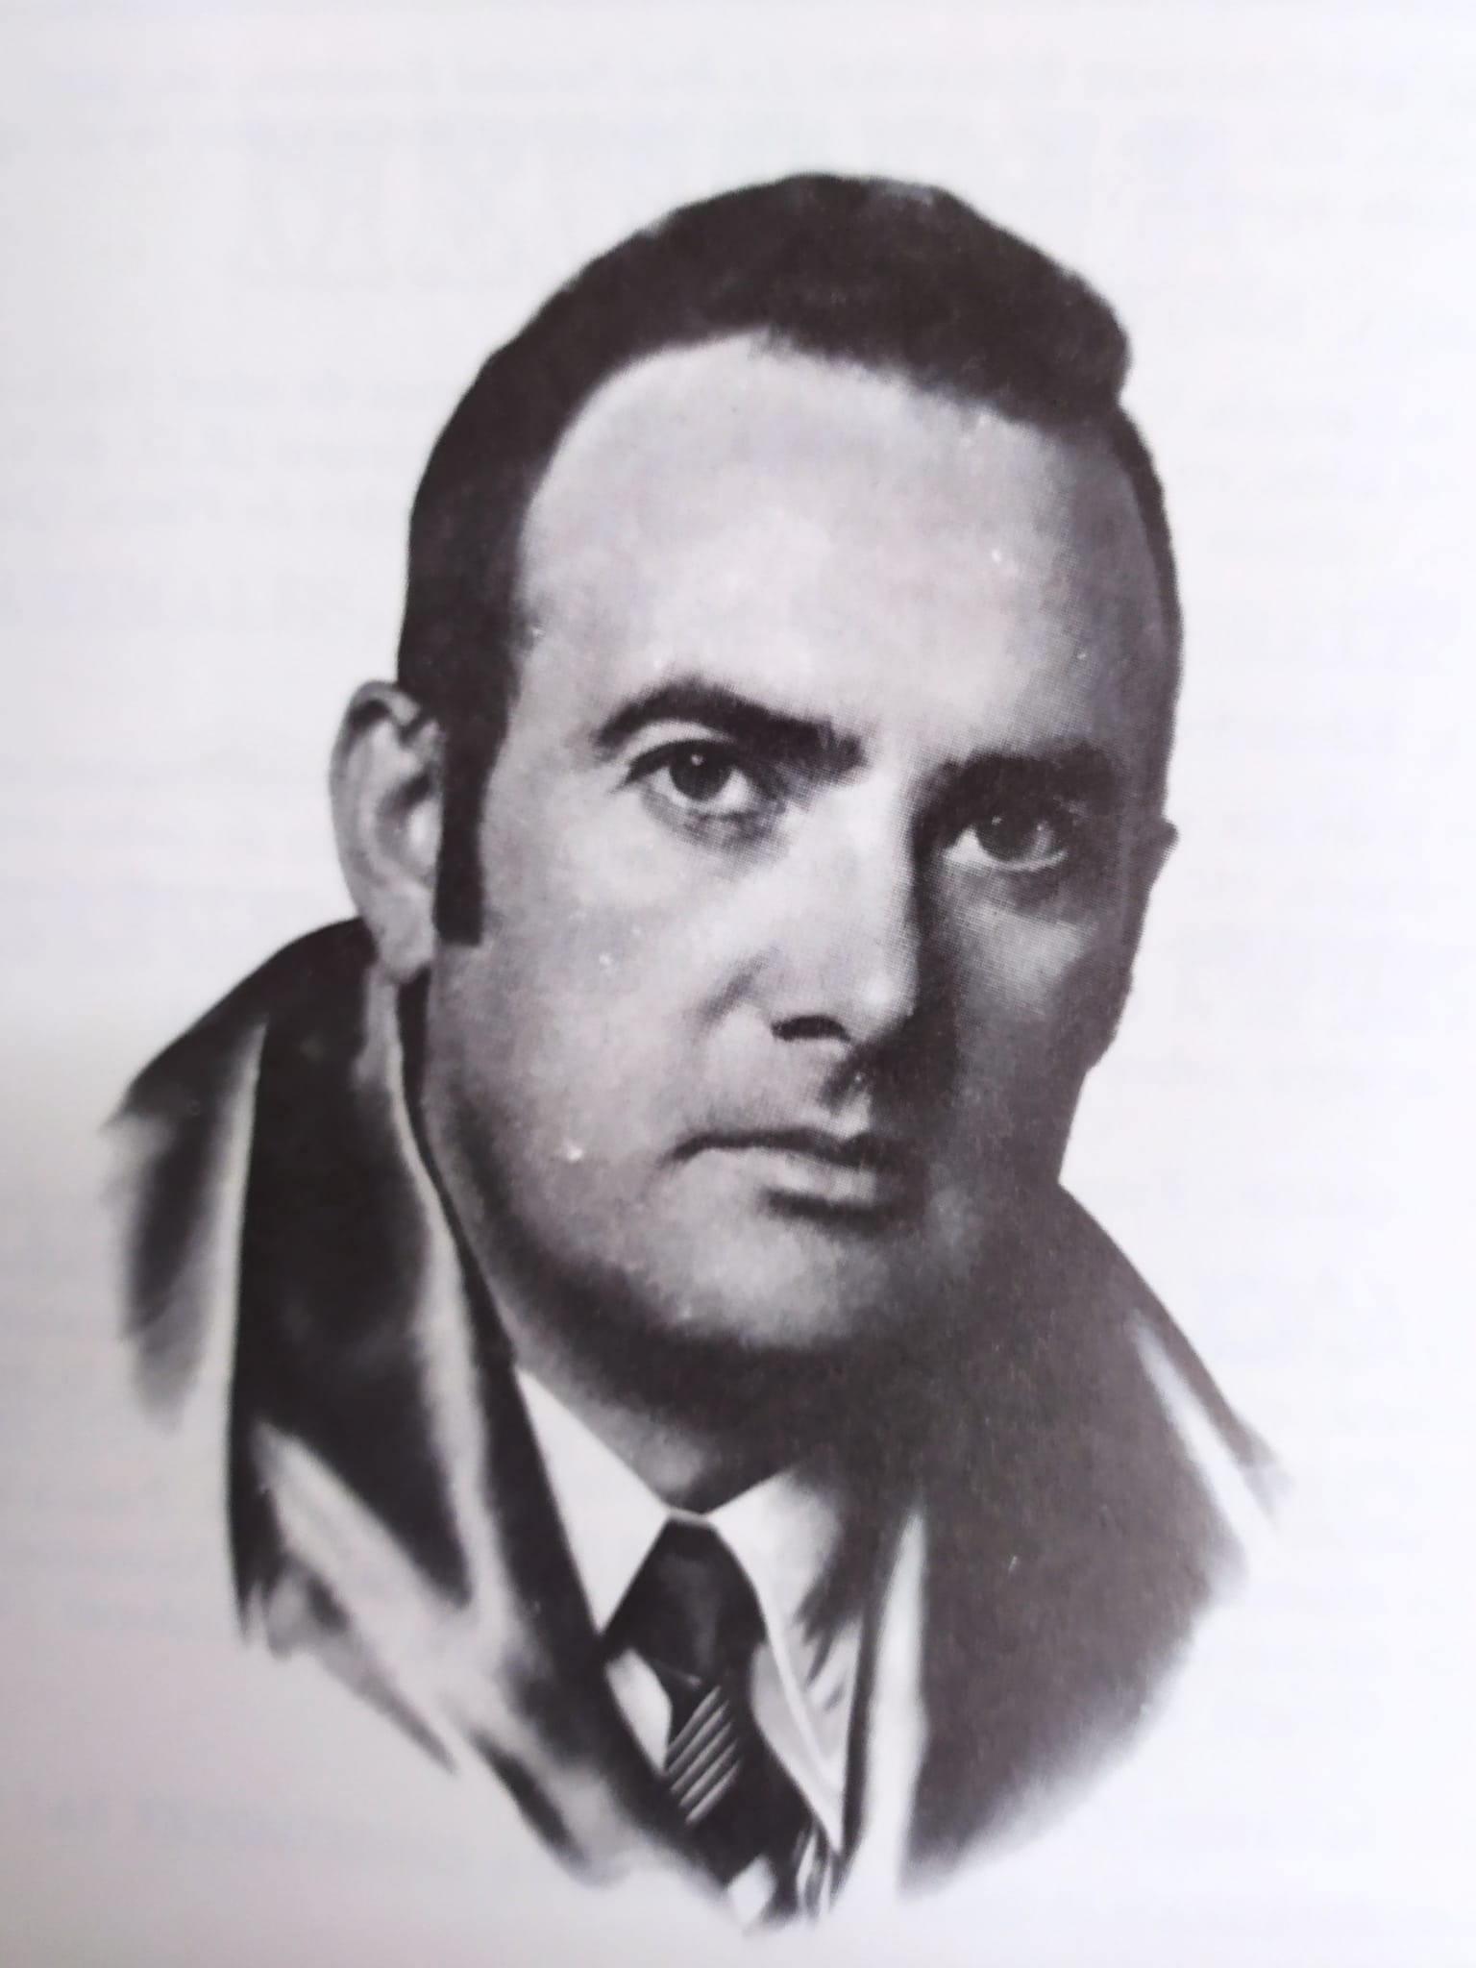
Introduction
Walter De La Mare (1873-1956) is one of the most delight and prolific modern poets and story tellers.
He studied at St. Paul’s school in London and started his careers as a lark in an oil company.
Then he devoted himself a literature. He wrote make stories under the pseudonym Walter Ramal. Then, he used his name to get name from the literary world.

Slide 3
The Father and the Four Sons
A Farmer has four sons and he asks his sons to learn profitable trades from for all places. All of the sons start themselves travel on the four directions.
Learning and Talent:
The elder son happens to meet an old man and he learns from the old man about the nimbleness of fingers.
Through that talent he can take away anything without disturbing anybody. The Second son has acquired telescope from another man and learns to see far off objects.
The Third son learns archery from his master and he can shoot anything in a single shot perfectly. The Fourth son becomes an expert tailor and can stitch any torn or broken things promptly.

Slide 4
They all return to their place and see their father. The father is highly elated and wants to see the talents of his sons.
On the next day, he asks them to come with him and takes them to the field. On showing a tree, he asks them what is on the high of the tree.
The second son, through the help of the telescope, sees a chaffinch hatching five eggs and tells him. The first son climbs on the tree and removes all the five eggs without disturbing the mother bird.
The third son shoots an arrow pointedly and it passes through all the five. At last, the fourth son stitches the eggs so well and finally the first son restores the eggs to the mother bird.

Slide 5
The Catastrophe and the Triumph Very soon, a catastrophe befalls on the country. A dragon snatches the prince of the country. The King announces that the one who saves the princes shall be her husband.
The farmer asks his son to try for the best. The four sons, reaches the palace and tells the king that they are ready to save the princess. But they don’t know about of the princess. The second son by the help of the telescope sees the Druid Be Eco-Friendly dragon keeping the princess in the place of one-day travel.
The king gives them a ship and by it they all go to save her. Very close to the island, they stay and the third son hesitates to shoot because it may kill the princess.
So, the first son by his talent brings the princes safely to the ship. When they sail back, the dragon chases them; while attack, the third son shoots the dragon and it falls on the ship, shattering it into pieces.
In crisis, the fourth son stitches the broken wood into a craft and all they reach the palace safely. The king and the father became very happy for their safe return.

Slide 6
In such condition, the king is confused to marry her princess to any of these men because all have contributed in saving her.
The brothers say that they don’t want to marry the princess but want to keep their father happy.
So, the king gives them twelve horses; each there, laden with precious things. The father and the sons live happily forever.

Slide 7
Conclusion
The story is a children’s story with good taste of excitement in it.
The story is retold in a memorable way and the fairy atmosphere is maintained throughout the story.

